Slide 1


World Energy Analysis
DSC 530 EDA Final Project
Paul Hart

Slide 2
Research Questions and Data Set
Research questions: What energy source does the world use for electricity the most? What energy source does the world consume the most? Out of the top 5 energy producing countries, which one uses the most fossil fuels?and which one uses the most green energy? The United States and China are the two top energy producing countries, is there a correlation between their main energy source and the main energy source for the world? Can a prediction be made on if fossil fuel consumption in the world will increase or decrease in the future?
Merged two datasets. Dataset 1 is energy consumption and dataset 2 is electricity generation from energy sources.
I am calling the final merged dataset energy_data, and it has 18 variables. These variables include country, year, and energy consumption in kilowatt-hour (kwh) for coal, oil, gas, nuclear, hydro, wind, solar, and other renewables. It also has energy generation as electricity in kilowatt-hour(kwh) for coal, oil, gas, nuclear, hydro, wind, solar, and other renewables.
Data source = https://ourworldindata.org

Slide 3
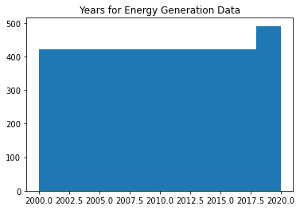
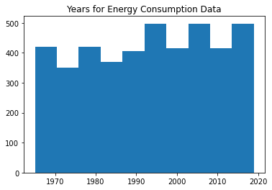
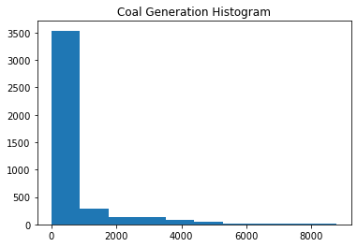
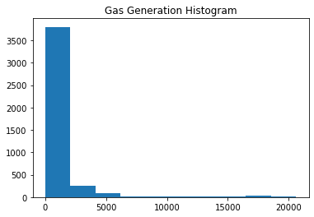
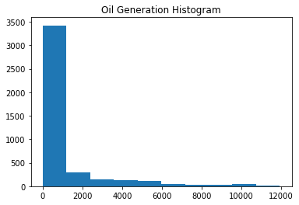
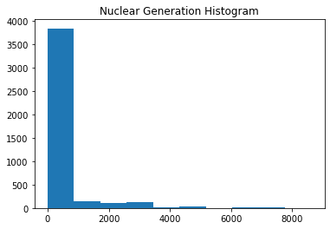
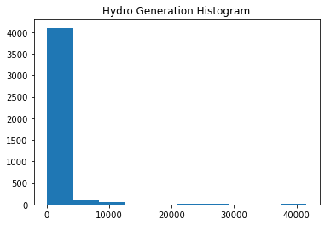
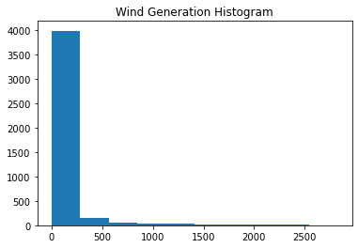

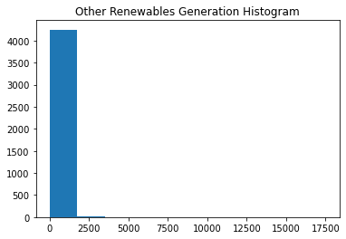
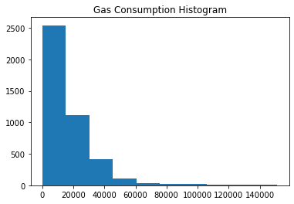
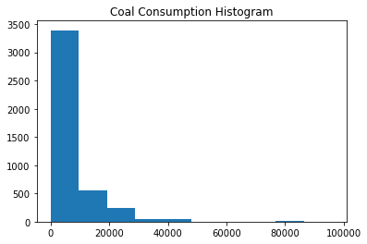
Variable Histograms

Slide 4
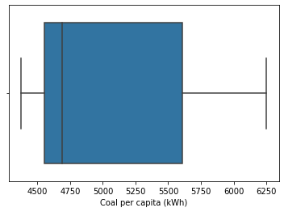
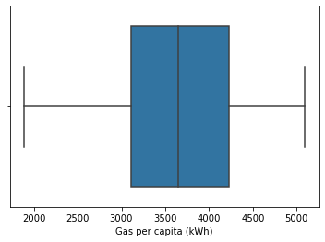
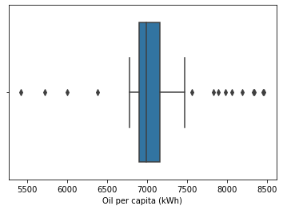
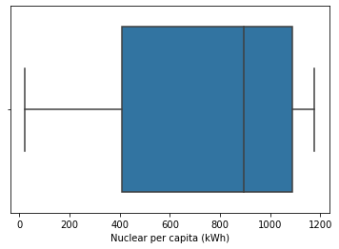
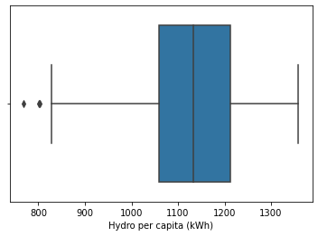
Outlier Visualization for Five Variables With Box Plots

Slide 5
Descriptive Statistics of Variables
 | Year-Gen | Coal electricity per capita (kWh) | Gas electricity per capita (kWh) | Oil electricity per capita (kWh) | Nuclear electricity per capita (kWh) | Hydro electricity per capita (kWh) | Wind electricity per capita (kWh) | Solar electricity per capita (kWh) | Other renewable electricity per capita (kWh) | Year-Con | Coal per capita (kWh) | Oil per capita (kWh) | Gas per capita (kWh) | Nuclear per capita (kWh) | Hydro per capita (kWh) | Wind per capita (kWh) | Solar per capita (kWh) | Other renewables per capita (kWh)
count | 4289 | 4269 | 4269 | 4269 | 4289 | 4289 | 4289 | 4289 | 4289 | 4290 | 4290 | 4284 | 4290 | 4290 | 4290 | 4290 | 4290 | 4290
mean | 2009.669 | 500.3475 | 897.1204 | 951.0998 | 306.4064 | 886.6688 | 73.25619 | 18.92709 | 129.0454 | 1993.078 | 5920.464 | 16714.34 | 10255.94 | 1480.345 | 3606.955 | 134.0031 | 29.37513 | 351.4983
std | 5.870967 | 1174.588 | 2431.534 | 1951.97 | 992.8058 | 3239.578 | 256.6062 | 65.93382 | 876.355 | 15.69646 | 8937.954 | 17316.75 | 22836.84 | 3398.947 | 10738.67 | 513.368 | 127.8526 | 2299.013
min | 2000 | 0 | 0 | 0 | 0 | 0 | 0 | 0 | 0 | 1965 | 0 | 124.142 | 0 | 0 | 0 | 0 | 0 | 0
25% | 2005 | 0 | 0 | 12.1601 | 0 | 0 | 0 | 0 | 0 | 1980 | 223.5473 | 5316.353 | 443.8388 | 0 | 85.19 | 0 | 0 | 0
50% | 2010 | 0 | 22.53414 | 131.9911 | 0 | 86.5431 | 0 | 0.016773 | 0.293399 | 1994 | 2425.589 | 12149.04 | 4082.877 | 0 | 576.743 | 0 | 0 | 7.227
75% | 2015 | 286.9456 | 734.1033 | 744.8166 | 0 | 610.3301 | 12.028 | 2.063675 | 44.73708 | 2007 | 8248.953 | 22638.97 | 10359.88 | 637.713 | 2124.323 | 4.74475 | 0.2955 | 154.2473
max | 2020 | 8774.913 | 20611.25 | 11933.94 | 8618.174 | 41592.81 | 2825.425 | 825.0938 | 17495.58 | 2019 | 96109.69 | 151237.3 | 278892.4 | 24721.76 | 105642.7 | 6928.363 | 1763.675 | 44322.65

Slide 6
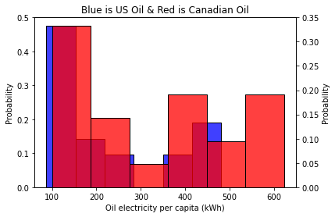
Comparison of Oil Generation in US and Oil Generation in Canada using PMF
The PMF shows that Canada uses more oil for electricity generation than the US.

Slide 7
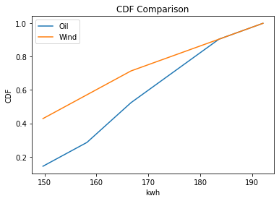
Comparison of World Electricity Generation between Oil and Wind
What is very interesting is that the CDF shows that the probability of electricity being from wind is higher than for oil.

Slide 8
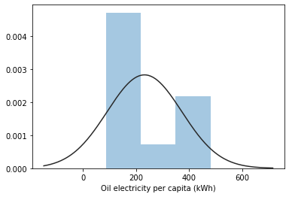
Normal Distribution of US Electricity Generation from Oil

Slide 9
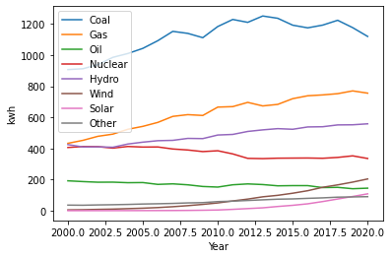
World Electricity Generation From Fossil Fuels
Coal is still the number one electricity producing energy source in the world

Slide 10
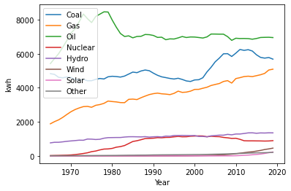
World Energy Consumption From Fossil Fuels
Oil is still the number one used energy source in the world.

Slide 11
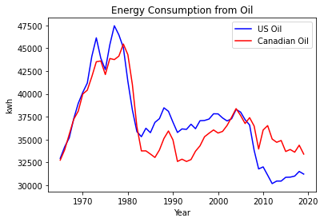
Time Series Graph of US Oil and Canadian Oil Consumption
Over the years the US has consumed more energy from oil than Canada, however in the last 10 years Canada has consumed more energy from oil than the United States.

Slide 12
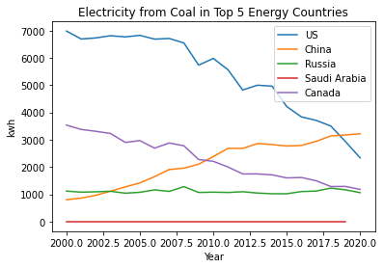
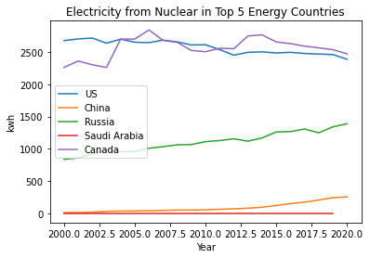
Top 5 Energy Country Plots on Coal and Nuclear
US and China currently use more coal than any other country. China has now passed the US in coal use around the years 2018 and 2019. The US coal use has been declining and the China’s coal use has been increasing.
Nuclear is one of the most used green energy sources, so I used this energy source to see which of the top 5 energy countries uses it the most. It looks like the US and Canada use the most nuclear green energy with Canada using it slightly more.

Slide 13
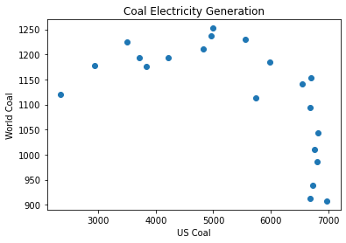
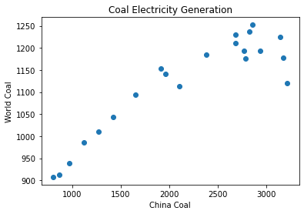
Coal Correlation and Scatter Plots
Weak to strong negative correlation between US and world electricity generation from coal
Strong positive correlation between China coal and world electricity generation from coal
US Coal and World Coal Correlation and T-Test
Rsquared = -0.6169274198601862
P value = 0.0028921241108922297
Ttest_indResult-statistic=13.267624914661617 pvalue=3.0992962989779534e-16)
China Coal and World Coal Correlation and T-Test
0.906763453110996
1.4752764680475756e-08
Ttest_indResult-statistic= 5.745697050627447
pvalue= 1.0764084766083994e-06

Slide 14
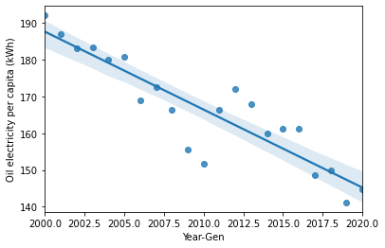
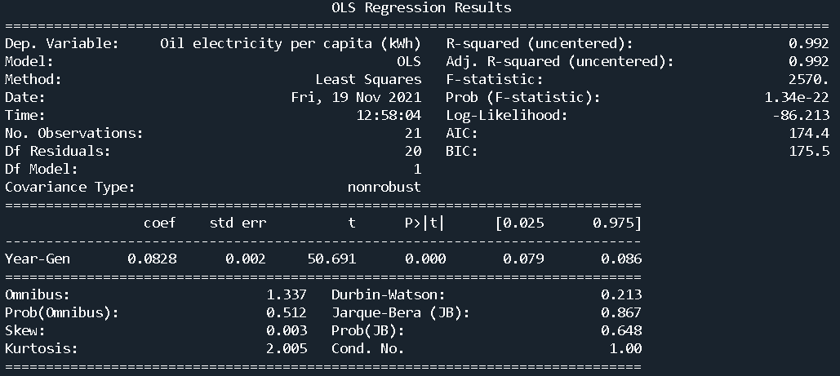
Regression Analysis of Future World Electricity Generation from Oil
The least squares regression analysis on the time series data for world electricity generation from oil shows that electricity generation will continue to slowly decline. The model results shows that for every year electricity from oil will decrease by 0.0828 kwh.

Slide 15
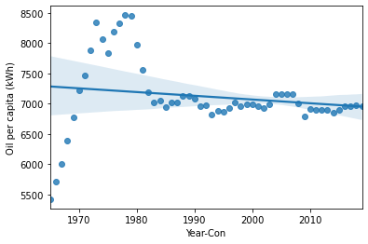
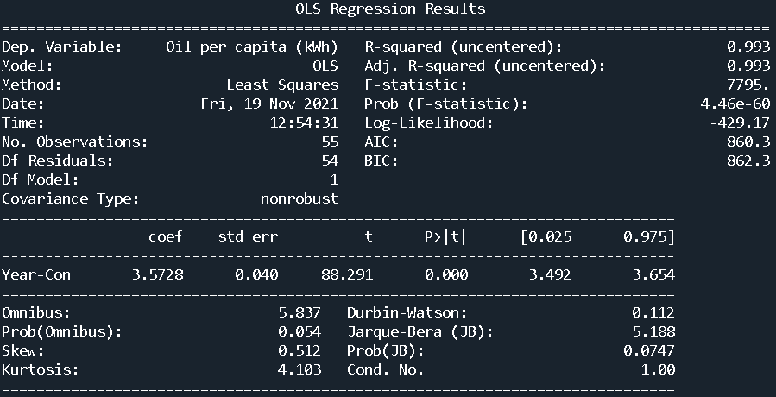
Regression Analysis of Future World Oil Consumption
The least squares regression analysis on the time series data for world oil consumption shows that oil consumption will actually increase by 3.5728 kwh for every year. So even though it oil consumption has flatlined according to the time series graph there will still be some increase in consumption over the years.

Slide 16
Energy Analysis Summary
Coal is the most used energy source in the world for electricity generation.
Oil is still the most consumed energy source in the world.
US and China use the most fossil fuels, mainly coal out of the top 5 producing energy countries.
US and Canada use the most green energy, mainly nuclear out of the top 5 producing energy countries.
The US used to consume more oil than Canada, but now Canada consumes more oil than the US.
Interesting enough, the cumulative distribution function (CDF) shows that wind is used more than oil for world electricity production.
US electricity generation from coal has a weak to strong negative correlation to world electricity generation from coal. This means the US is on the right track to using less coal.
China electricity generation from coal has a strong positive correlation to world electricity generation from coal. This shows that China is a significant contributor to the worlds use of coal.
Regression analysis has shown that world electricity generation from oil will continue to decrease in the future.
Regression analysis has shown that world oil consumption will actually slightly increase in the near future.

